Slide 1
Socket Programming in C/C++

Slide 2
Contents
Socket
Socket Structures
Socket Functions
TCP Example
TCP Client
TCP Server
UDP Example
UDP Client
UDP Server
Functions for Multicasting

Slide 3
Socket
Socket
Source ( IP , Port )
Destination ( IP , Port )
Protocol ( TCP , UDP , SCTP)
Connection Oriented / Connection less

Slide 4
Socket Structures
sockaddr
sockaddr_in
Connection information. Used by connect , send , recv etc
in_addr
IP address in long format
hostent
The IP addresses of a hostname. Used by gethostbyname()

Slide 5
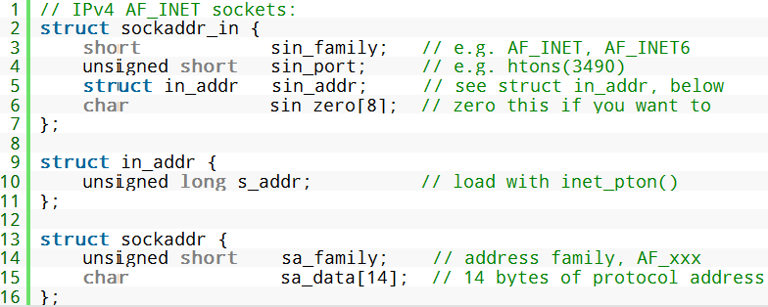
sockaddr , sockaddr_in & in_addr

Slide 6
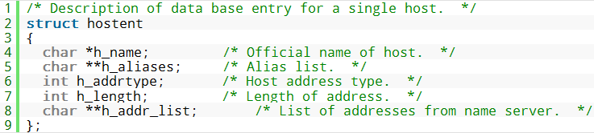
hostent

Slide 7
Socket Functions
TCP | UDP
socket bind listen accept connect write /send read / recv | socket bind sendto recvfrom

Slide 8
Socket Functions
socket: creates a socket of a given domain, type, protocol (buy a phone)
bind: assigns a name to the socket (get a telephone number)
listen: specifies the number of pending connections that can be queued for a server socket. (call waiting allowed)
accept: server accepts a connection request from a client (answer phone)
connect: client requests a connection request to a server (call)
send, sendto: write to connection (speak)
recv, recvfrom: read from connection (listen)
shutdown: end the call

Slide 9
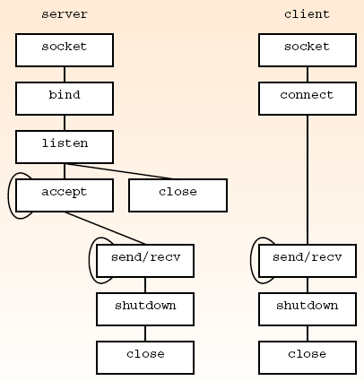
Sockets Functions used for TCP

Slide 10
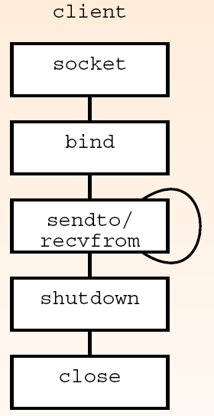
Sockets Functions used for UDP

Slide 11
Socket Functions
Supporting Functions
For Port Numbers
htons / htonl
Host to Network Byte Order (short-16/long-32)
ntohs/ntohl
Network to Host Byte Order (short-16/long-32)
For IP Address
inet_ntoa
convert an IP address to dotted format
inet_addr
convert an IP address to a long format
For Host
gethostbyname

Slide 12
Socket Functions
Supporting functions Example
htons & inet_addr
struct sockaddr_in server;
server.sin_port = htons( 80 );
server.sin_addr.s_addr = inet_addr("74.125.235.20");

Slide 13
socket()
int socket (int domain , int type , int protocol)
domain (Address Family)
AF_INET (IP version 4)
AF_INET6 (IP version 6)
Type :
SOCK_STREAM (connection oriented TCP protocol)
SOCK_DGRAM (connectionless UDP protocol)
Protocol :
0 , (zero) to detect protocol according to the type
IPPROTO_TCP
returns Socket Descriptor on success

Slide 14
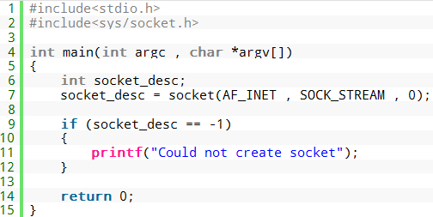
socket()

Slide 15
bind()
int bind(int sid , struct sockaddr *addrptr , int len)
sid :
socket ID obtained through socket()
*addrptr: (for local host)
Family dependent address
Used to bind IP and Port number to a socket
len
Length of the addrptr

Slide 16
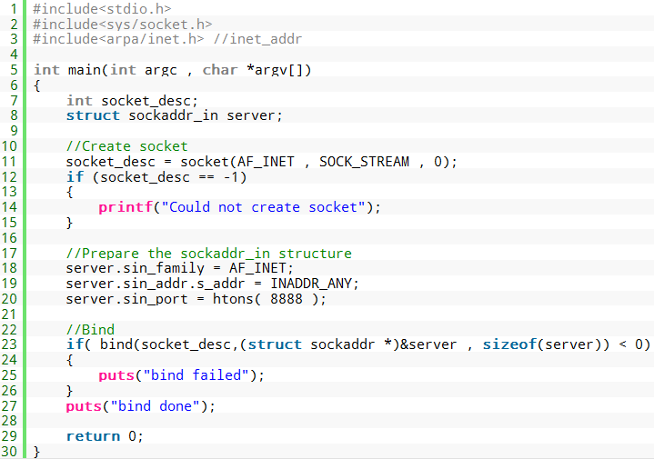
bind()

Slide 17
listen()
int listen(int sid , int size)
sid:
Socket descriptor obtained through socket()
size:
Number of connections that can be handled concurrently
returns 0 on success or -1 in failure
Example
listen ( socket_desc , 5 );

Slide 18
connect()
int connect(int sid , struct sockaddr *addrptr , int len)
sid :
socket ID obtained through socket()
*addrptr: (for remote host or Destination)
Family dependent address
Used to specify destination (IP and Port)
len
Length of the addrptr
returns 0 on success and -1 on failure

Slide 19
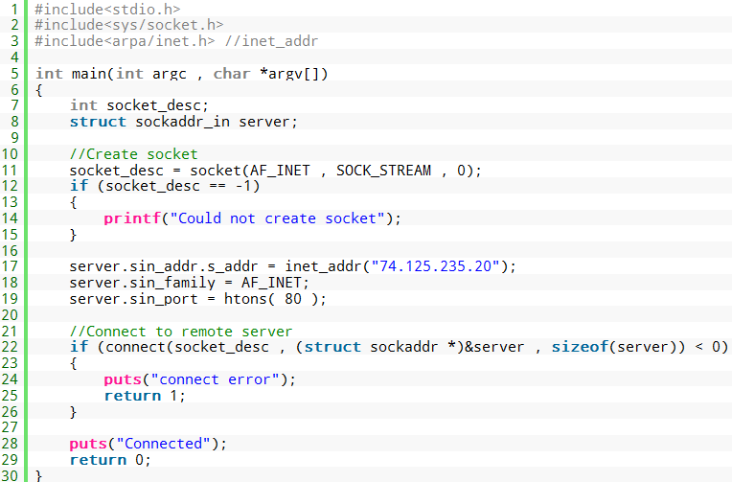
connect()

Slide 20
accept()
int accept(int sid , struct sockaddr *addrptr , int len)
sid :
socket ID obtained through socket()
*addrptr: ( remote host who requested to connect)
Family dependent address
Used to get remote client address (IP and Port)
len
Length of the addrptr
returns new sock descriptor and address of a remote client who requested the connection by connect()

Slide 21
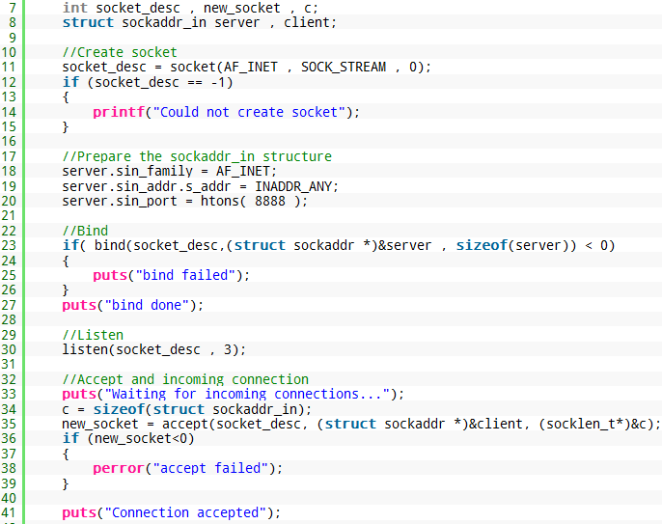

Slide 22
send() / recv()
int send (int sid , const char *buffer, int len , int flag)
Int recv (int sid , const char *buffer, int len , int flag)
int sendto (int sid , const char *buffer, int len , int flag
struct sockaddr *addrptr, int addrptr_len)
int recvfrom (int sid , const char *buffer, int len ,int flag
struct sockaddr *addrptr, int addrptr_len)

Slide 23
Getting IP of a host name/domain
struct hostent * gethostbyname()

Slide 24
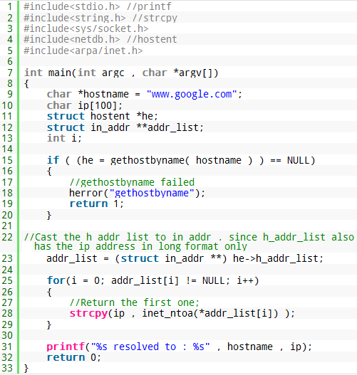

Slide 25
Functions for UDP communication
int sendto
int sid
const char *buffer, int len , int flag
struct sockaddr *addrptr, int addrptr_len
int recvfrom
int sid ,
const char *buffer, int len , int flag
struct sockaddr *addrptr, int addrptr_len

Slide 26
UDP Receiver
sd=socket(AF_INET, SOCK_DGRAM, 0);
servAddr.sin_family = AF_INET;
servAddr.sin_addr.s_addr = htonl(INADDR_ANY);
servAddr.sin_port = htons(SERVER_PORT);
rc = bind (sd,(struct sockaddr *)&servAddr, sizeof(servAddr));
n = recvfrom(sd, msg, MAX_MSG, 0,(struct sockaddr *)&cliAddr ,
sizeof(cliAddr)

Slide 27
UDP sender
sd = socket(AF_INET,SOCK_DGRAM,0);
remoteServAddr.sin_family = AF_INET;
remoteServAddr.sin_addr.s_addr = htonl(SERVER_IP);
remoteServAddr.sin_port = htons(SERVER_PORT);
rc = sendto(sd, msg, strlen(msg)+1, 0,
(struct sockaddr *) &remoteServAddr,
sizeof(remoteServAddr));

Slide 28
Functions for Multicasting
int getsockopt(
int sid,
int level, int optname, void* optval,
int* optlen);
int setsockopt(
int sid,
int level, int optname, const void* optval,
int optlen);
int IN_MULTICAST(ntohl(Addr.sin_addr.s_addr))

Slide 29
Multicasting – Function Arguments
Socket ID
AF_INET
SOCK_DGRAM or SOCK_RAW
Level (identifies the layer that is to handle the option, message or query)
SOL_SOCKET (socket layer)
IPPROTO_IP (IP layer)

Slide 30
Multicasting – Function Arguments
optname (option for multicasting)
 | setsockopt() | getsockopt()
IP_MULTICAST_LOOP | yes | yes
IP_MULTICAST_TTL | yes | yes
IP_MULTICAST_IF | yes | yes
IP_ADD_MEMBERSHIP | yes | no
IP_DROP_MEMBERSHIP | yes | no

Slide 31
Options Value for Multicasting
loopback
u_char loop; // loop = 0 or 1
setsockopt(socket, IPPROTO_IP, IP_MULTICAST_LOOP, &loop, sizeof(loop));
TTL
u_char ttl; // default = 1 for own network only, 0 to 255
setsockopt(socket, IPPROTO_IP, IP_MULTICAST_TTL, &ttl, sizeof(ttl));
Interface (multicast datagram sent from)
struct in_addr interface_addr;
setsockopt (socket, IPPROTO_IP, IP_MULTICAST_IF, &interface_addr, sizeof(interface_addr));

Slide 32
Options Value for Multicasting
Membership request structure
struct ip_mreq
{ /* IP multicast address of group */
struct in_addr imr_multiaddr;
/* local IP address of interface */
struct in_addr imr_interface;
};
Add Members
struct ip_mreq mreq;
setsockopt (socket, IPPROTO_IP, IP_ADD_MEMBERSHIP, &mreq, sizeof(mreq));
Drop Members
struct ip_mreq mreq;
setsockopt (socket, IPPROTO_IP, IP_DROP_MEMBERSHIP, &mreq, sizeof(mreq));

Slide 33
Multicast Receiver
sd = socket(AF_INET,SOCK_DGRAM,0);
servAddr.sin_family=AF_INET;
servAddr.sin_addr.s_addr=htonl(INADDR_ANY);
servAddr.sin_port=htons(SERVER_PORT);
rc = bind(sd,(struct sockaddr *) &servAddr, sizeof(servAddr))
/* join multicast group */
mreq.imr_multiaddr.s_addr=mcastAddr.s_addr;
mreq.imr_interface.s_addr=htonl(INADDR_ANY);
rc = setsockopt(sd,IPPROTO_IP,IP_ADD_MEMBERSHIP,(void *) &mreq,
sizeof(mreq));
n = recvfrom(sd,msg,MAX_MSG,0,(struct sockaddr *) &cliAddr,&cliLen);

Slide 34
Multicast Sender
//simple UDP sender
sd = socket(AF_INET,SOCK_DGRAM,0);
setsockopt(sd,IPPROTO_IP,IP_MULTICAST_TTL, &ttl,sizeof(ttl)
servAddr.sin_family = AF_INET;
servAddr.sin_addr.s_addr = htonl(SERVER_IP);
servAddr.sin_port = htons(SERVER_PORT);
rc = sendto(sd,argv[i],strlen(argv[i])+1,0,
(struct sockaddr *) &servAddr, sizeof(servAddr));

